Slide 1




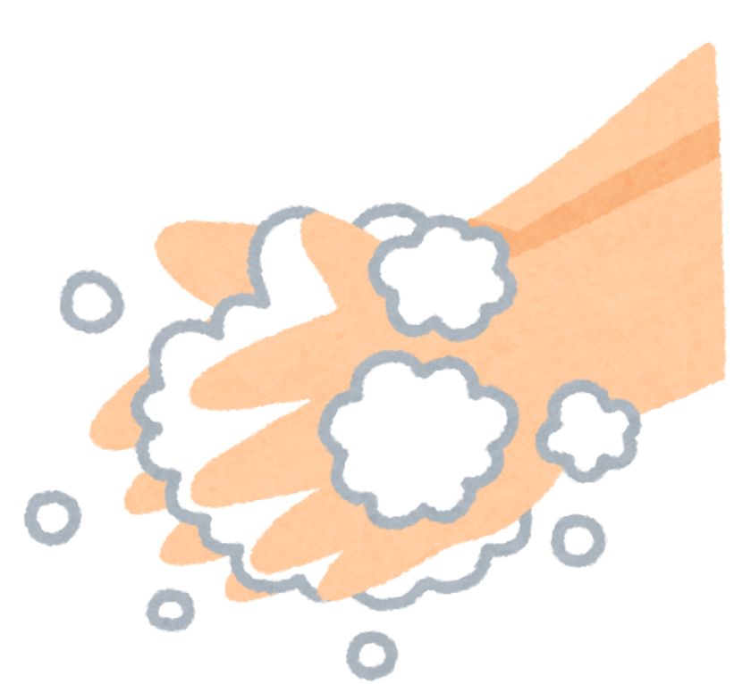
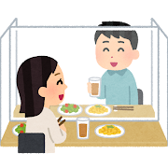



Preventing the Spread of COVID-19
○ When eating out, you need to be careful to avoid not only becoming infected yourself but also infecting others. We can continue to support restaurants if we all work together and do our part.
Things to Please Keep in Mind When Eating Out
To safely enjoy good food and good conversation
○ Some restaurants may have restrictions on seating or how they serve food. Restaurant workers are doing their best to prevent the spread of infection. Please be patient and follow their instructions.
Treat restaurant workers with respect and consideration.
Wash or disinfect your hands before eating.
Keep your mask on except when eating.
Do not linger over food or drinks.
Avoid the 3 Cs* and cooperate with ventilation arrangements.
* 3 Cs: Closed spaces, Crowded places, and Close-contact settings
Do not share a glass or top-up someone else’s drink.
Do not drink too much. Avoid talking in a loud voice.
Avoiding busy times of day is also effective.
Do not share spoons or chopsticks.
Get delivery or take-out when possible.
Please download COCOA, the COVID-19 Contact-Confirming Application.
For details, visit
MHLW website

